Slide 1
Road Sign and Road State Mobile Notification Application
TASK VI: DATABASE DESIGN AND IMPLEMENTATION

Slide 2
Table of contents
01
Introduction
02
Choosing the right database type
03
Modelling the database
04
Conclusion

Slide 3
Introduction
01
Designing a database for a mobile application backend is a critical step in ensuring the
scalability
performance
efficiency of the application.

Slide 4
1.1. Database Models
Data modelling is the process of diagramming data flows.
This flow diagram is used to define the characteristics of the data formats, structures, and database handling functions to efficiently support the data flow requirements.
After the database has been built and deployed, the data model lives on to become the documentation and justification for why the database exists and how the data flows were designed.

Slide 5
1.2. Why data modelling is important?
A comprehensive and optimized data model helps create a simplified, logical database that
eliminates redundancy
reduces storage requirements
enables efficient retrieval.

Slide 6
1.3. Levels of data abstraction
Conceptual model
Logical model
The logical model adds detail to the conceptual model but does not include specifications for the database itself as the model can be applied to various database technologies and products.
This is the “big picture” model that represents the overall structure and content but not the detail of the data plan.
Physical model
Contains enough detail to enable technologists to create the actual database structure in hardware and software to support the applications that will use it. The physical data model is specific to a designated database software system.

Slide 7
Choosing the right database type
02
Relational databases store data in tables with predefined schemas and use SQL to query and manipulate data.
Non-relational databases store data in collections of documents, key-value pairs, graphs, or other formats, and use different query languages or APIs to access data.

Slide 8
2.1. Why use NoSQL database
Handle large volumes of data at high speed with a scale-out architecture.
Store unstructured, semi-structured, or structured data
NoSQL databases support widely used data formats
Developer-friendly and wide community base.

Slide 9
2.2. Chosen Database: Firebase
Real-time Database and Cloud Functions
Geospatial Functionality
Scalability and Security
Offline Capabilities (Firestore)
User Management

Slide 10
03
Modelling the database

Slide 11
1. Conceptual model
The focus is to represent data as a user will see it in the “real world.”

Slide 12
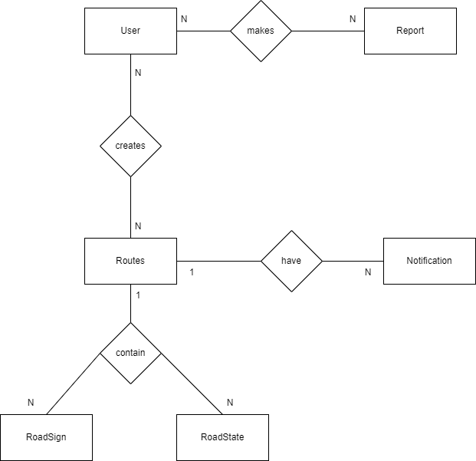

Slide 13
2. Logical model
Includes the specific attributes of each entity, the relationships between entities, and the cardinality of those relationships

Slide 14
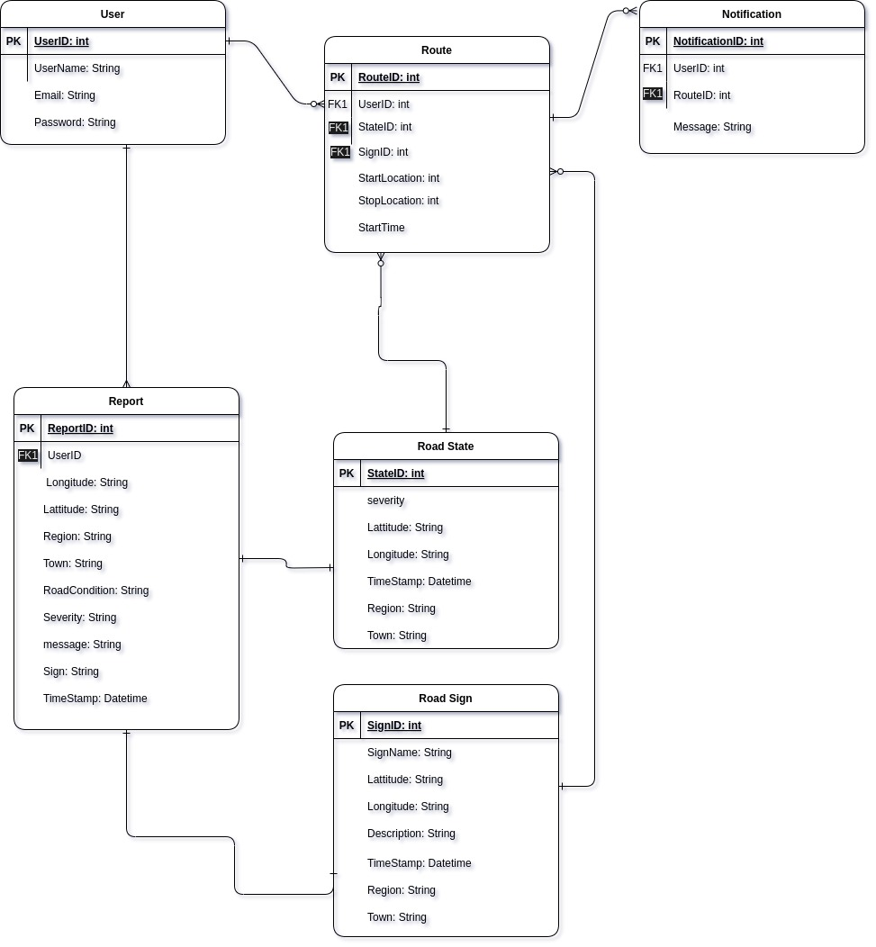

Slide 15
3. Physical model
Describes the technology-specific and database-specific implementation of the data model.

Slide 16
Firebase is a document-oriented databases or NoSQL document store.
Data is stored as JSON rather than basic columns/rows.
When data is added to the JSON tree, it becomes a node in the existing JSON structure with an associated key.

Slide 17
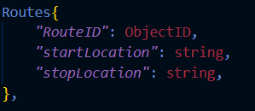
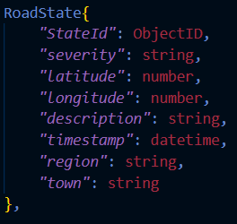
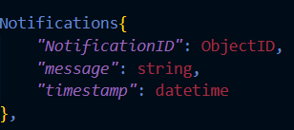

Slide 18
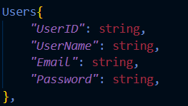
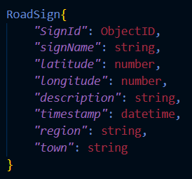
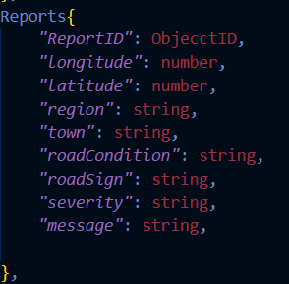

Slide 19
04
Conclusion
Analysis of the application needs let to the conclusion that a NoSQL database offers a more suitable solution due to its scalability, flexibility for real-time data, and efficient handling of geospatial queries.
Implementing a well-designed and secure database, the road state and road sign notification application can provide valuable information to drivers, improving road awareness and potentially enhancing safety on the roads.

Slide 20
Thanks!
Does anyone have any questions?

